Slide 1
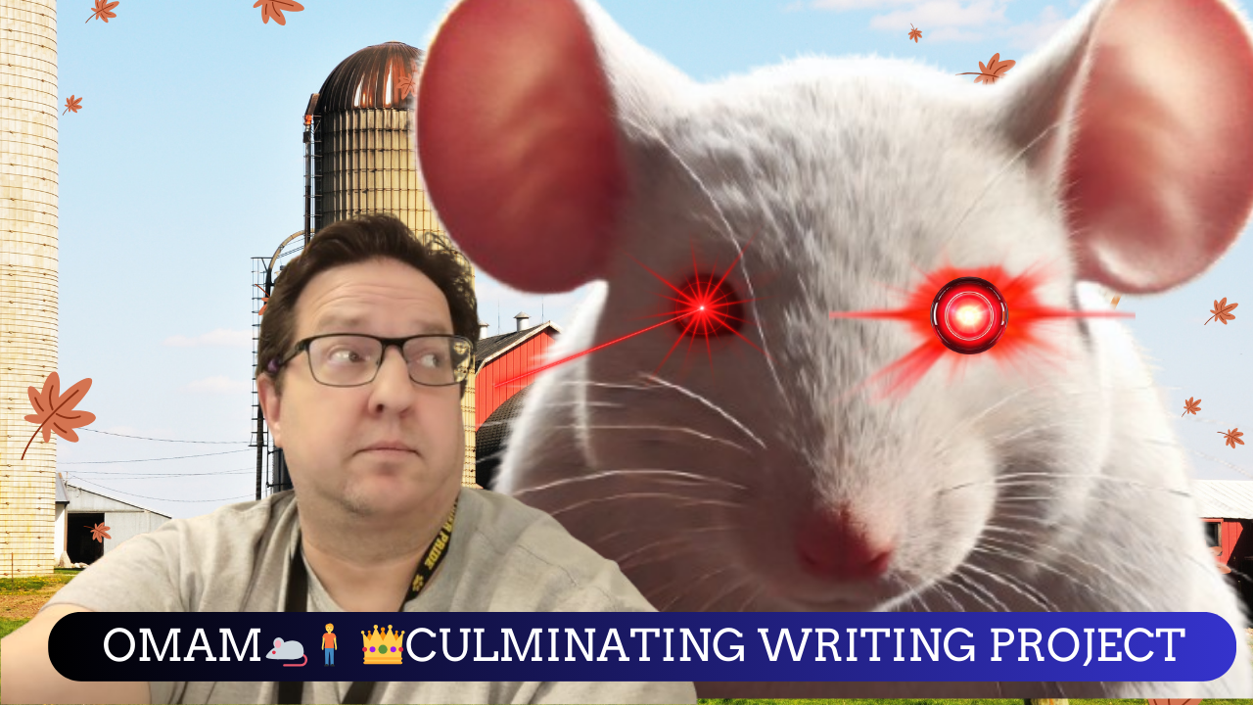
OMAM🐁🧍 👑Culminating Writing Project Tutorials (Playlist)
https://youtube.com/playlist?list=PLoL1gUMFjot66JBOncgeIiMNKaRiJwHF3&si=6G28rGdIHk_uPN6_

Slide 2
How to Complete the Scaffolded Assignments
OMAM🐁🧍 👑Culminating Writing Project | Tutorial

Slide 3
How to Assemble the Chunks
OMAM🐁🧍 👑Culminating Writing Project | Assembling the Chunks (Part 1)
OMAM🐁🧍 👑Culminating Writing Project | Copying Through Asymmetrical Rows (Addendum 1)
OMAM🐁🧍 👑Culminating Writing Project | Title Creation (Part 2)
OMAM🐁🧍 👑Culminating Writing Project | MLA Essay Format (Part 3)
OMAM🐁🧍 👑Culminating Writing Project | MLA Style Citation: Brackets and Ellipses (Part 4)

Slide 4
How to Submit the Completed Final Draft
OMAM🐁🧍 👑Culminating Writing Project | Submitting on Turnitin.com (Part 5)

